Slide 1


Hello & welcome to presentation
N E X T
WELCOME MESSAGE
Presentations are communication tools that can be used as demonstrations, lectures, speeches, reports, and more. It is mostly presented before an audience.
LET’S GET STARTED

Slide 2
Hello there!
I’m Ahmed Atef, and I'll be sharing with you my beautiful ideas.
N E X T

Slide 3
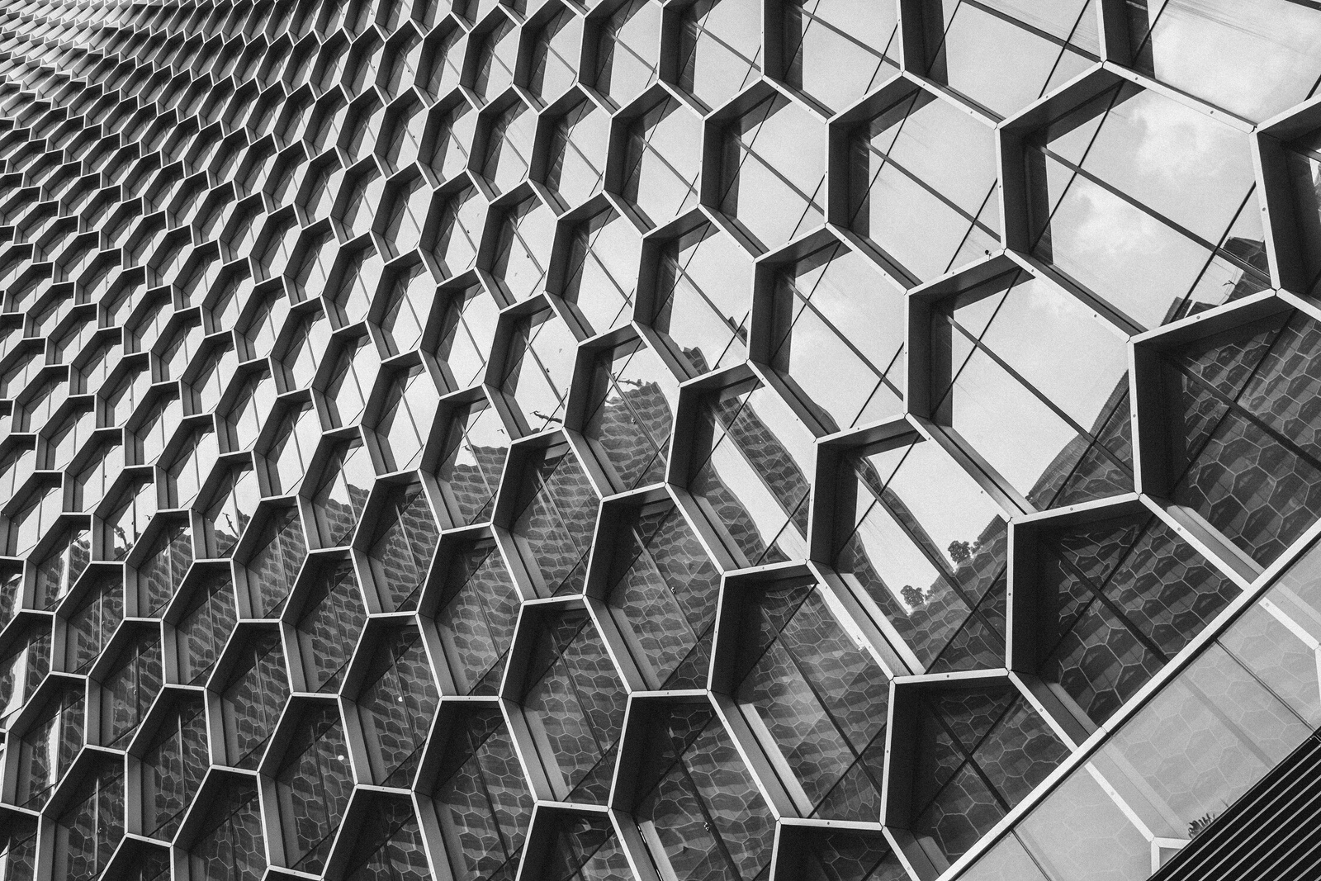
Agenda
Website Designs
N E X T
HTML website code
CSS website code

Slide 4
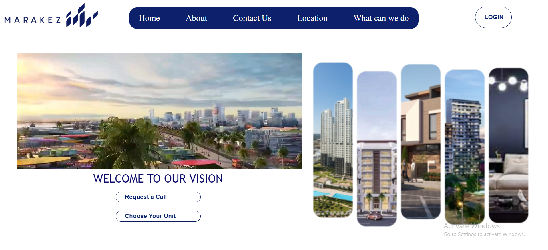
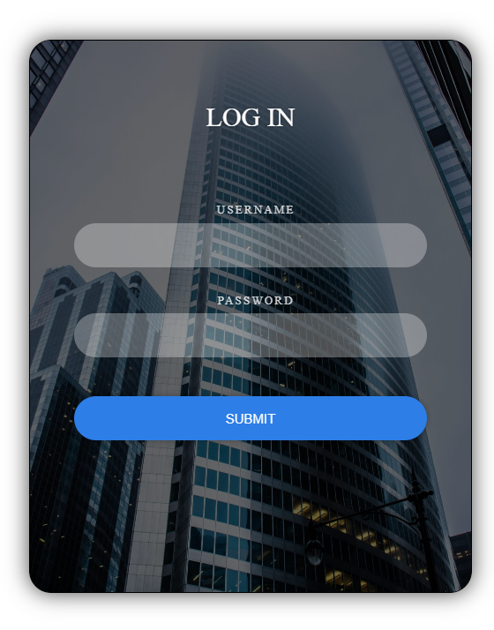

Portifolio
Website Designs
HTML website code
N E X T
CSS website code
N E X T

Slide 5
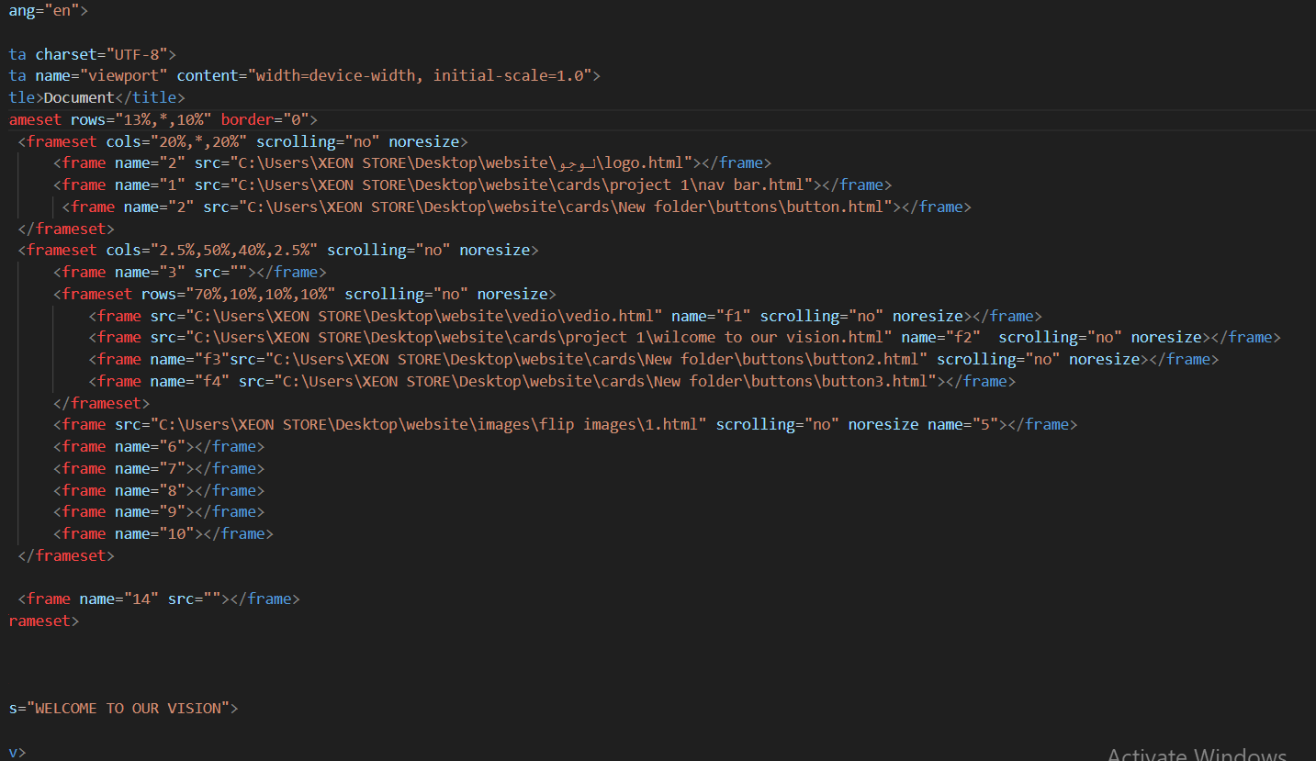
Portifolio
Website Designs
HTML website code
N E X T
CSS website code
N E X T

Slide 6
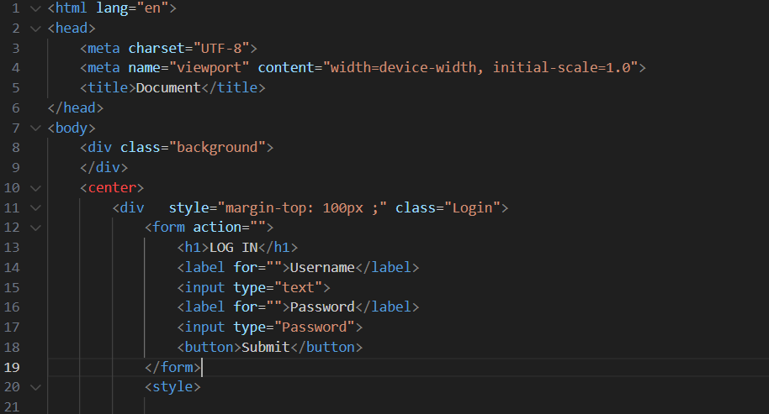
Portifolio
Website Designs
HTML website code
N E X T
CSS website code
N E X T

Slide 7
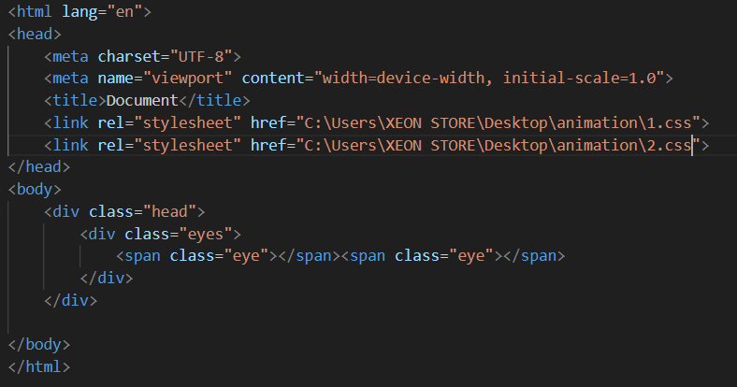
Portifolio
Website Designs
HTML website code
N E X T
CSS website code
N E X T

Slide 8
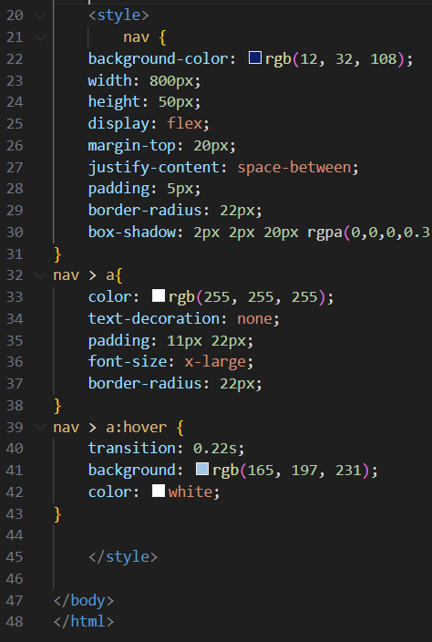
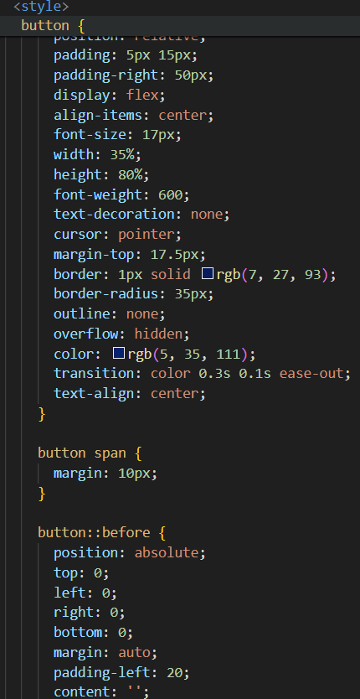
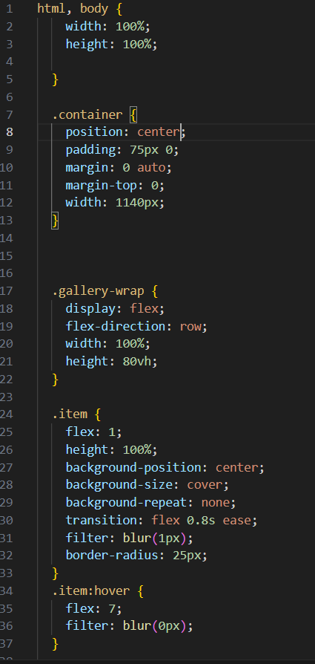
CSS website code
Website Designs
HTML website code
N E X T
CSS website code

Slide 9
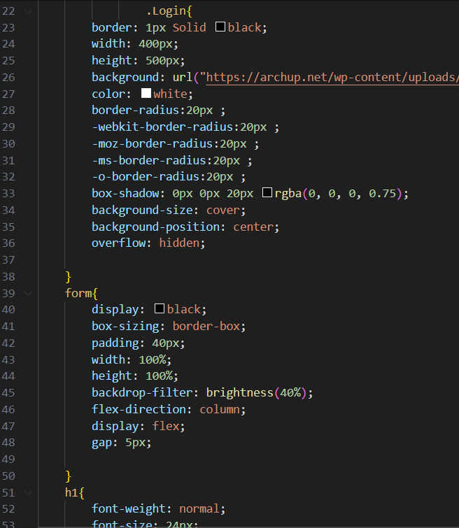
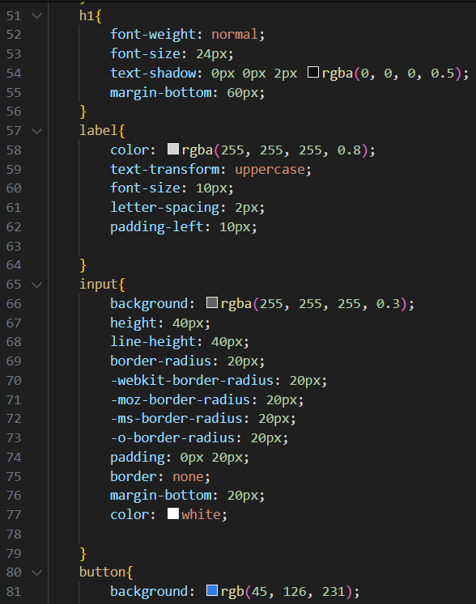
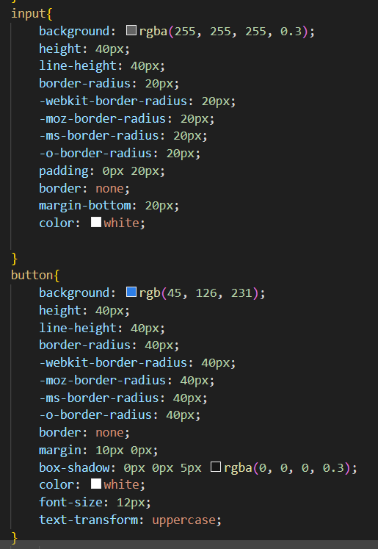
CSS website code
Website Designs
HTML website code
N E X T
CSS website code
N E X T

Slide 10
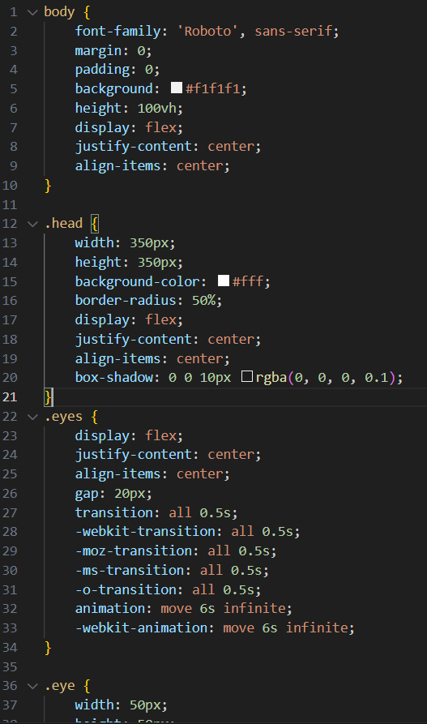
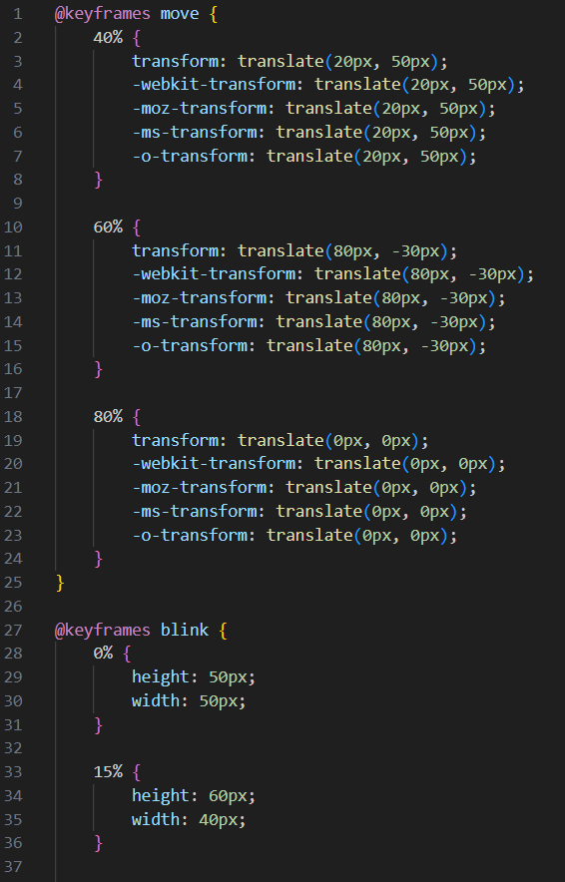
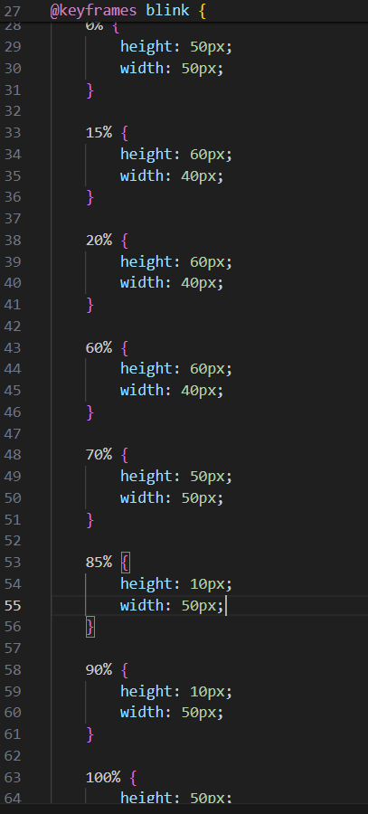
CSS website code
Website Designs
HTML website code
N E X T
CSS website code
N E X T

Slide 11
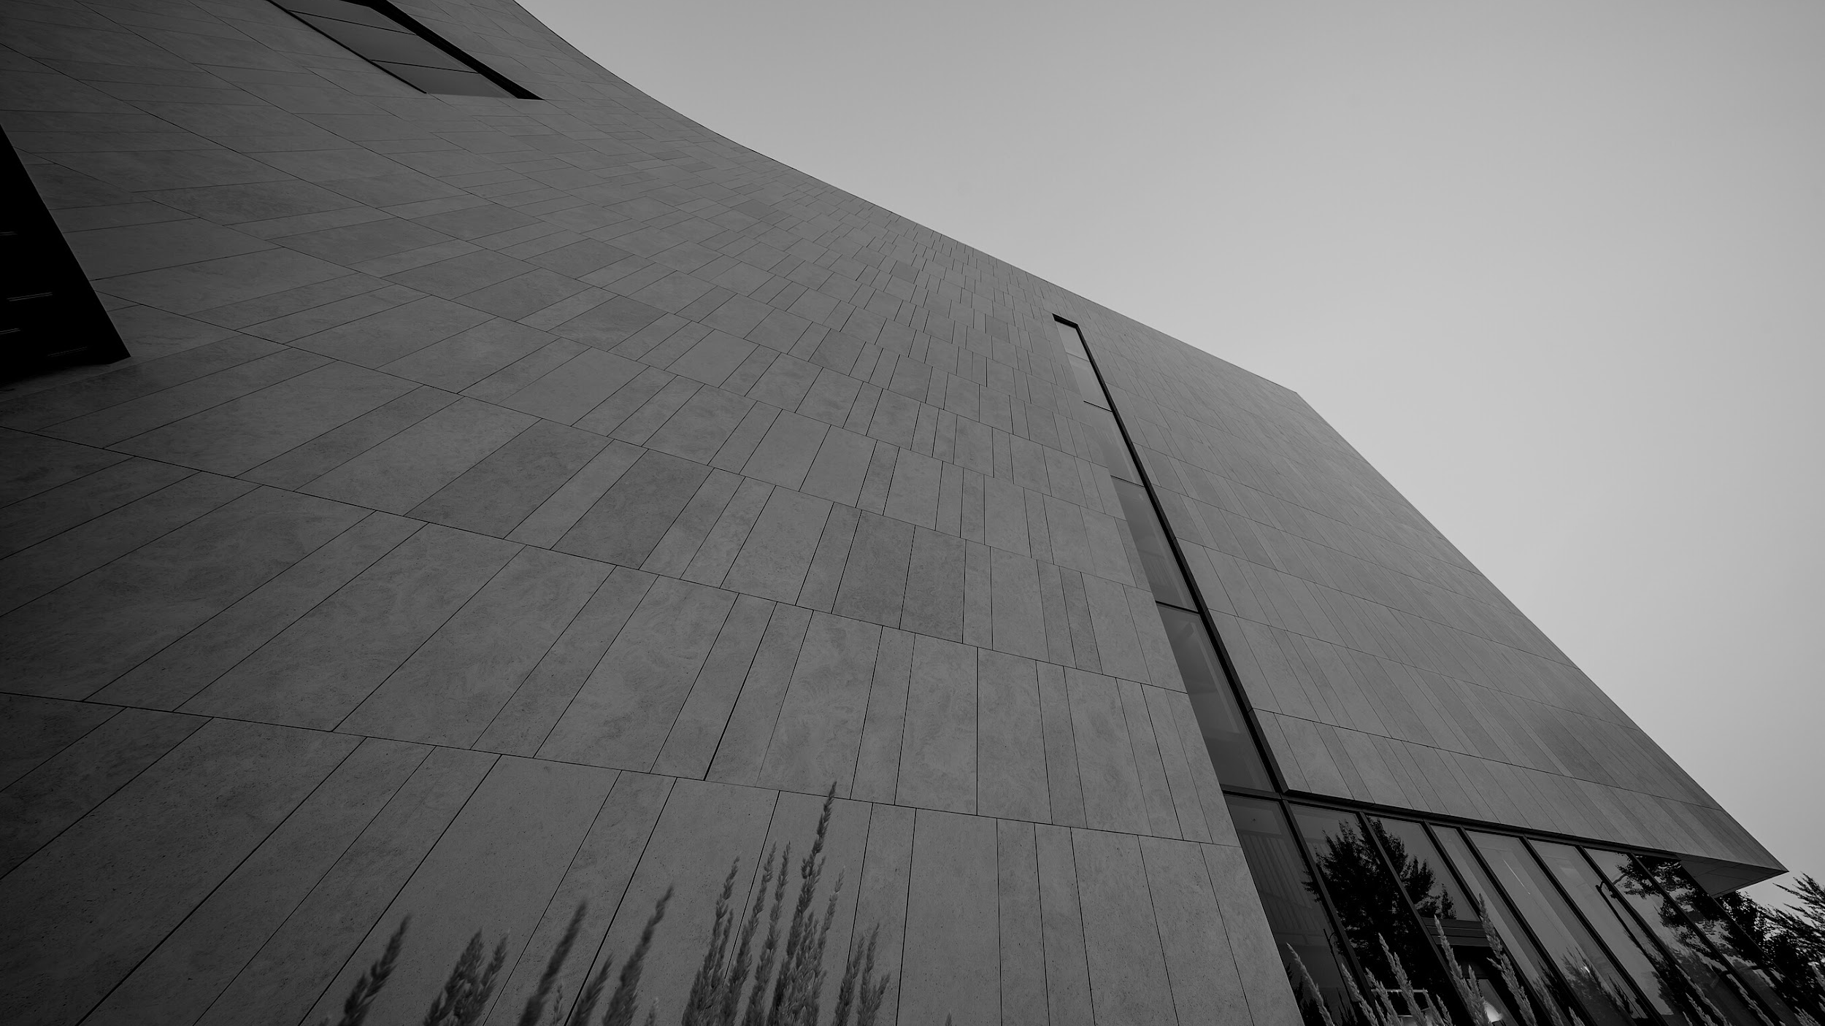
It's so lovely to meet all of you!
Thank you for listening.

